Slide 1

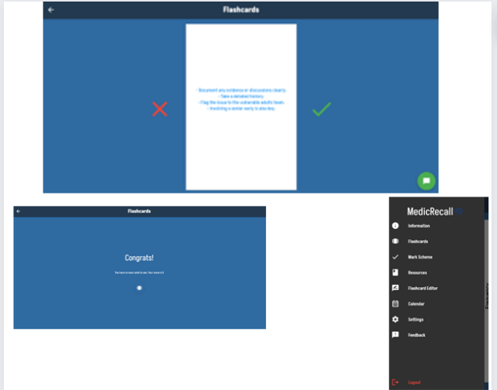
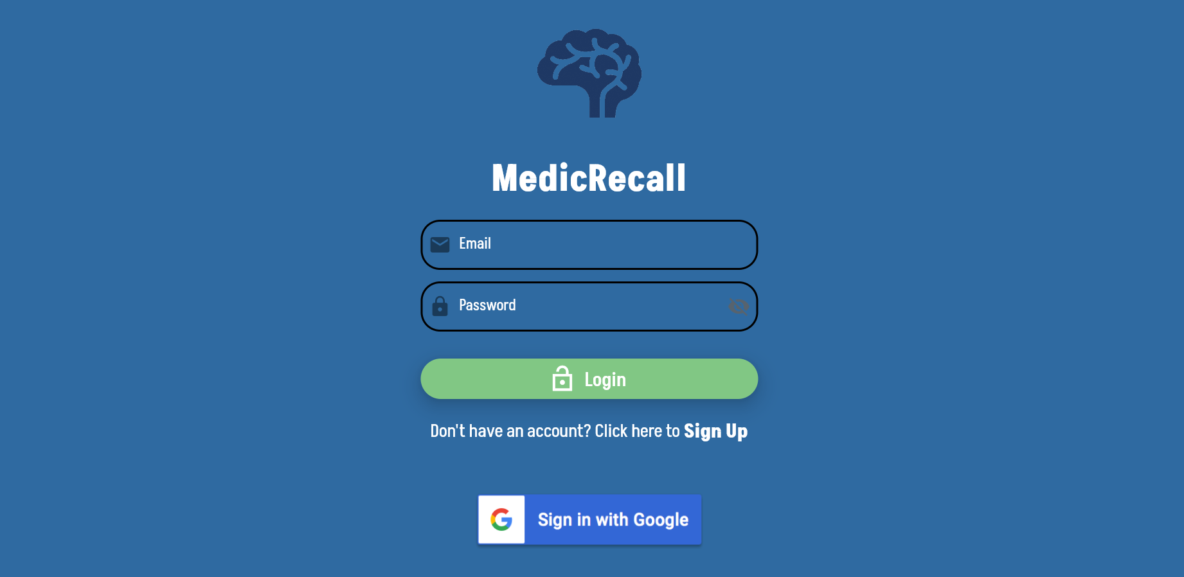
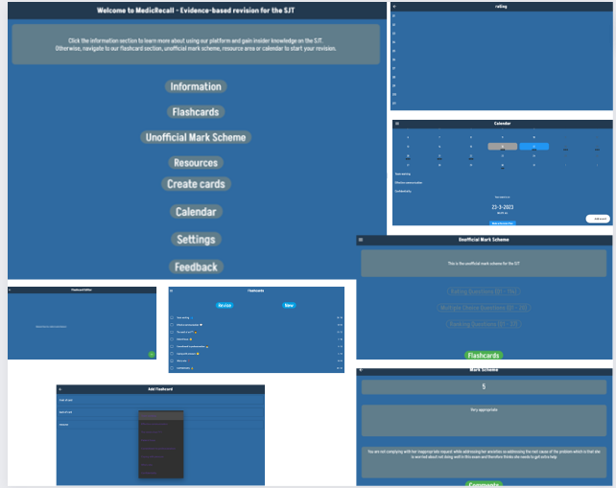
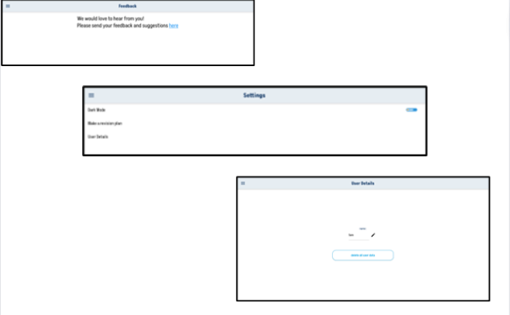
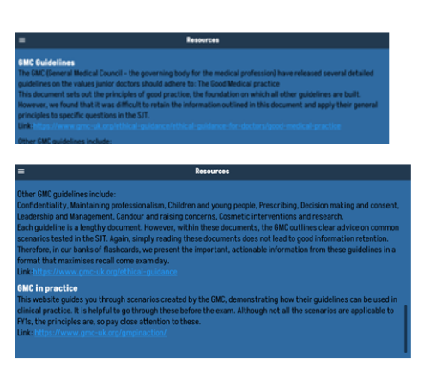
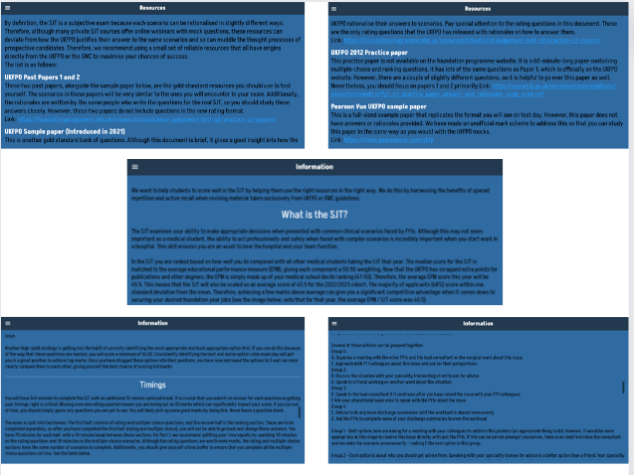
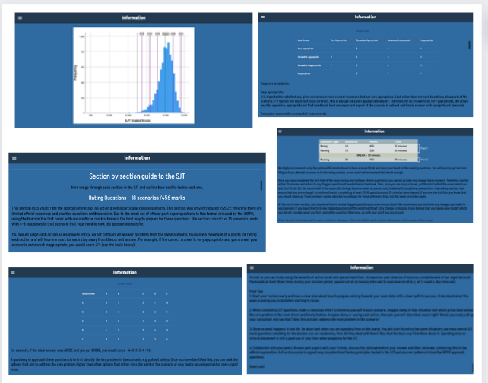
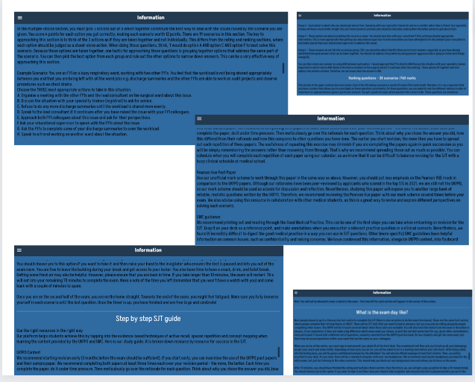
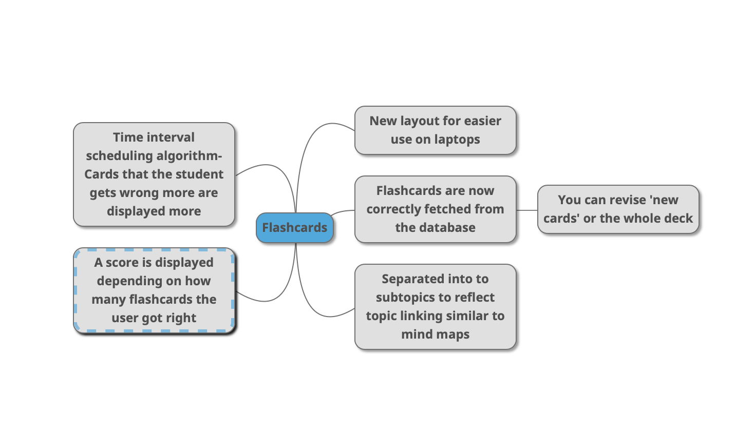
MedicRecall
Revision application for medicine students
Lauren Hill, Lucas Mockeridge, Ally Park, Ireneusz Swierczynski
MedicRecall is a revision app for medical students studying for the situational judgement test(SJT). Similar to other revision apps such as Anki and Quizlet, it builds on proven revision methods such as active recall and concept mapping to provide an effective way to take SJT mocks and revise flashcards. They can use the flashcards already provided or make their own. It is a web application programmed in Dart/Flutter with the possibility for it to be run as a mobile application.
Firebase
Firebase is a Google-provided database service. We chose to use it to allow for effective continuity from the work of last year's team. We used it to store:
Users
Flashcards both pre-set and created by the user
Store questions and the matching answers for the mock SJT
New Features
Detailed testing for all new functions. E.g. Time-based revision algorithm
Mark scheme syncs with appropriate questions
Menu sidebar and logo both direct to the landing page
UI changes:
-Coloured headings
-Graphs and images and tables
-URLs are used to link the user to other resources
-Added content and renamed certain sections
-Redesigned sidebar
-Improved functionality of back button
-Dropdown menu for flashcard subtopics
-Bolding where necessary
-Checkboxes show how much research has been done ✅
“Wrong” or “Correct” are displayed accordingly when a card is swiped
Time-based algorithm to implement space repetition
Swiping functionality-User shows that they have got a flashcard correct by ‘swiping right’
Try it for yourself:
Github-
spe-uob/2022-MedicRecall (github.com)
Wix Site-
medicreacall.com
Web application-
https://flashcard-6edc2.web.app/#login
E-mail-
medicrecall@gmail.com
User details functionality placed in settings
The number of flashcards a user gets correct is displayed after the deck has been revised
Feedback screen to identify unknown errors
Dark mode
Loading animation

